Slide 1
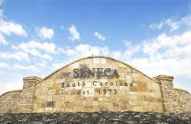
Seneca, SC
City of Opportunity

Slide 2
When was Seneca founded?
1873
Do the math! How many years ago was that?
Notes:
Let the students guess what year it was founded? Answer: 2013-1873=140

Slide 3
If you answered…
147
You’re correct! And you’re pretty good at math!
That was a long time ago wasn’t it?
Are any of you 147 years old?

Slide 4
Before we start our tour….
Put on your thinking caps…
Seneca has changed a lot over
the years. Keep an eye out for
things that look the same and
things that look different.
Think about why some things change and why some things stay the same.

Slide 5
Main Street Then
Corner of what is now Main St. and Depot St. Circa early 1900s

Slide 6
Main Street Now

Slide 7
Main Street
What businesses do you think were on Main Street in the early 1900s?
What businesses are on Main Street now?
What kind of businesses does a city need?
Notes:
Answers:
Question One—General Stores, Department Stores, Drug Stores, Grocery Stores, etc…
Question Two—Not many businesses…Young Fashions, Doctors office, etc…
Question Three—grocery stores, clothing stores, home improvement stores, drug stores, etc…

Slide 8
Main Street Then
Circa early 1900s

Slide 9
Main Street Now

Slide 10
Main Street
Have the buildings changed?
What has changed about the buildings?
Is there anything different about the street?
Notes:
Answers:
Question One—A little bit. Most of the buildings are still the same.
Question Two—window changed, business changed, outsides have been painted or covered.
Question Three—Street was dirt and now it is paved

Slide 11
Norton-Thompson Park Then
Circa early 1900s

Slide 12
Norton-Thompson Park Now

Slide 13
Norton-Thompson Park
What has changed?
Is the park better now than it was in the early 1900s?
Notes:
Answers:
Question One: There’s trees, fence, gazebo in early 1900s. Now it’s a bus stop and grass.
Question Two: Opinion, answers will vary

Slide 14
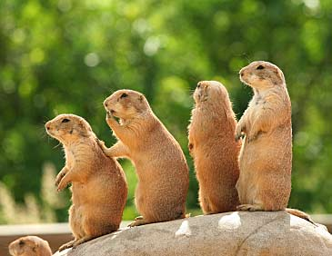
Norton-Thompson Park
Did you know that prairie dogs were brought in from Texas and placed in the park?
They all died because they could not survive the cold winter.

Slide 15
Main Street from Railroad Park

Slide 16
Main Street from Railroad Park

Slide 17
What Changed?
What’s missing?
What’s different about the buildings?
Notes:
Answers:
Question One: The Park, some buildings.
Question Two: Painted, new businesses, etc..

Slide 18
All Aboard…

Slide 19
Did you know…
Seneca was built when the railroad was being built.
Seneca is the only city in Oconee County to have two railroad lines. If Seneca didn’t have both lines it wouldn’t be the biggest city in the County
The two railroads were the Atlanta & Richmond Airline Railway and the Blue Ridge Railroad

Slide 20
The Depot Then
Train Depot 1926

Slide 21
The Depot Now

Slide 22
The Depot
Does it look the same?
How was the depot used in 1926?
How is the depot used now?
Notes:
Answers:
Question One—It looks similar. Different roof, paint, etc…
Question Two: Used as a place to pick up and drop off passengers and goods.
Question Three—It is not used how it was in 1926. Not really used at all

Slide 23
Passenger Depot

Slide 24
Have you seen that?
Q: Did you ever see the passenger depot in Seneca?
A: You have never seen the passenger depot because it burned down in the early 1900s.

Slide 25
Ram Cat Alley Then

Slide 26
Ram Cat Alley Now

Slide 27
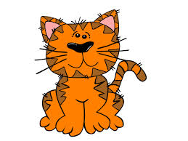
Why is it called Ram Cat Alley?
Ram Cat Alley was the location of many grocery stores and meat markets in early Seneca. They smelled all the delicious meats and fish that was being delivered to the stores. It is said that there would be so many cats that you couldn’t ram another one into the alley. So that’s how we get the name: Ram Cat Alley!

Slide 28
Ram Cat Alley Then

Slide 29
Ram Cat Alley Now

Slide 30
Ram Cat Alley
How has Ram Cat Alley changed?
What kind of businesses are located on Ram Cat Alley now?
What kinds of businesses would there have been in the early 1900s on Ram Cat Alley?

Slide 31
How old is that building?
Sometimes we can tell how old a building is by the its architecture, or the style of the building.
Sometimes the buildings themselves will give us clues….

Slide 32
Look Up, Look Down, Look All Around!

Slide 33
Look Up, Look Down, Look All Around!

Slide 34
Look Up, Look Down, Look All Around!

Slide 35
Look Up, Look Down, Look All Around!
All of these buildings gave us little clues about how old they were.
One building even had the year it was built in a stone on the wall!
Other’s had paintings of signs and advertisements that can help us find out when they were built.

Slide 36
Old Buildings
Look at this building. It looks like there are windows there but its all covered up! Why would we cover up windows?
Notes:
In earlier times we didn’t have electricity and lights so we needed windows to let natural sunlight in. Now we have electricity, we don’t need as many windows

Slide 37
Businesses in Early Seneca
Citizens Bank Circa Early 1900s

Slide 38
Citizens Bank Building Now

Slide 39
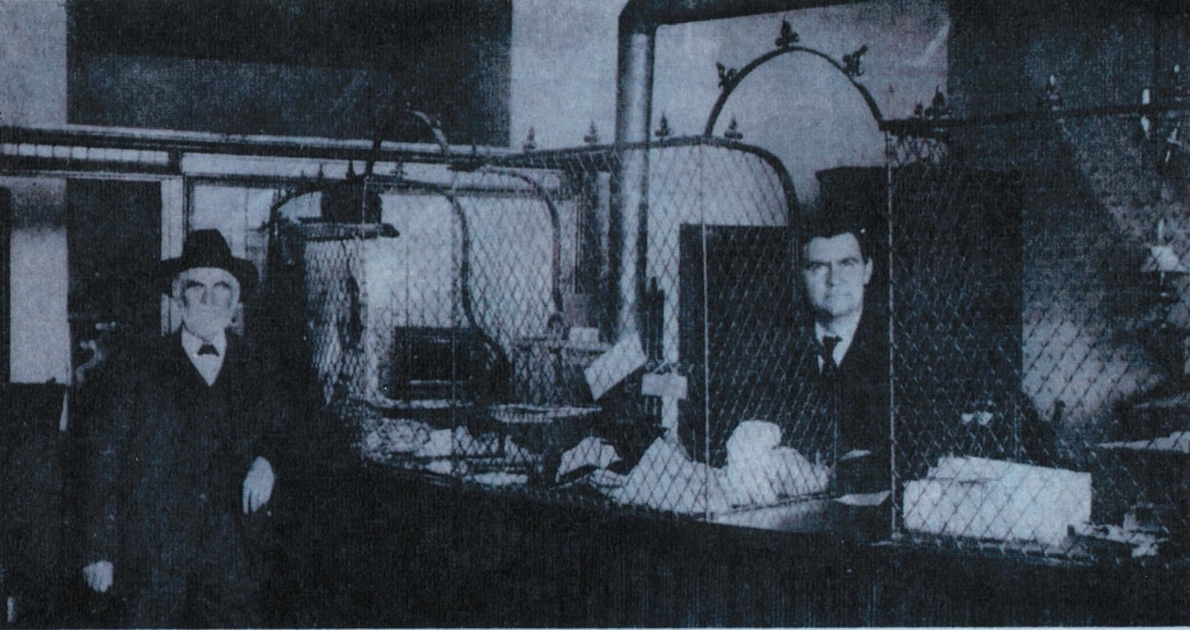
Citizens Bank
Why would someone in early 1900s Seneca need a bank?
What happened to the building it looked different?
Banker and Customer in Citizens Bank

Slide 40
Hotels
Did you know that downtown Seneca had 3 hotels in the early 1900s?
They were the Keowee Hotel, Oconee Inn, and Palmetto Inn.
Why do you think that Seneca had 3 hotels?
Notes:
Seneca had 3 hotels because many people were traveling on the trains and needed a place to stay the night to catch a different train.

Slide 41
The Oconee Inn

Slide 42
The Palmetto Inn

Slide 43
The End of Our Tour
Before you take those thinking caps off….
How do you think the history of Seneca has shaped how Seneca is today?
Do you think it’s better to live in Seneca now or 100 years ago?

Slide 44
www.oconeehistorymuseum.org

