Slide 1
How-To History: Locating Historic Cemeteries
Leslie Hagerty
Director/Curator
Oconee History Museum

Slide 2
Cemeteries: Outdoor Museums
Cemeteries provide a tangible & lasting link to the past.
Cemeteries can be examined as a whole unit or as individual graves.
Cemeteries are a wealth of information
Genealogical
Examples: personal details, family connections, etc…
Historical
Examples: migration trends, town/area settlement, epidemics/disasters, etc…
Anthropological
Examples: religious beliefs, social/cultural practices, etc…
Archaeological
Examples: ground depressions, oddly-placed stones or plants, mounds, etc…

Slide 3
Tombstone Tourists
It pays to visit a cemetery in person.
Points of etiquette & safety:
Get permission to access private property.
Who owns it?
Get permission to perform any clearing or maintenance on private property.
Do no harm. Avoid rubbings & litter.
Be careful! Watch for dangerous wildlife, vegetation, holes, stones, unstable terrain, etc…
Be prepared! Bring what you need.
Be aware of your surroundings.
Be respectful of graves.
Look at the front & back of tombstones…also footstones
What you can learn:
Vital information & photos
Family relationships
Previously unknown children
Military service information
Membership in fraternal, civic, or religious organizations
Accomplishments
Country of origin
Religion
Cause of death
Look at neighboring graves
2nd marriages, extended family
Epidemics or local tragedies

Slide 4
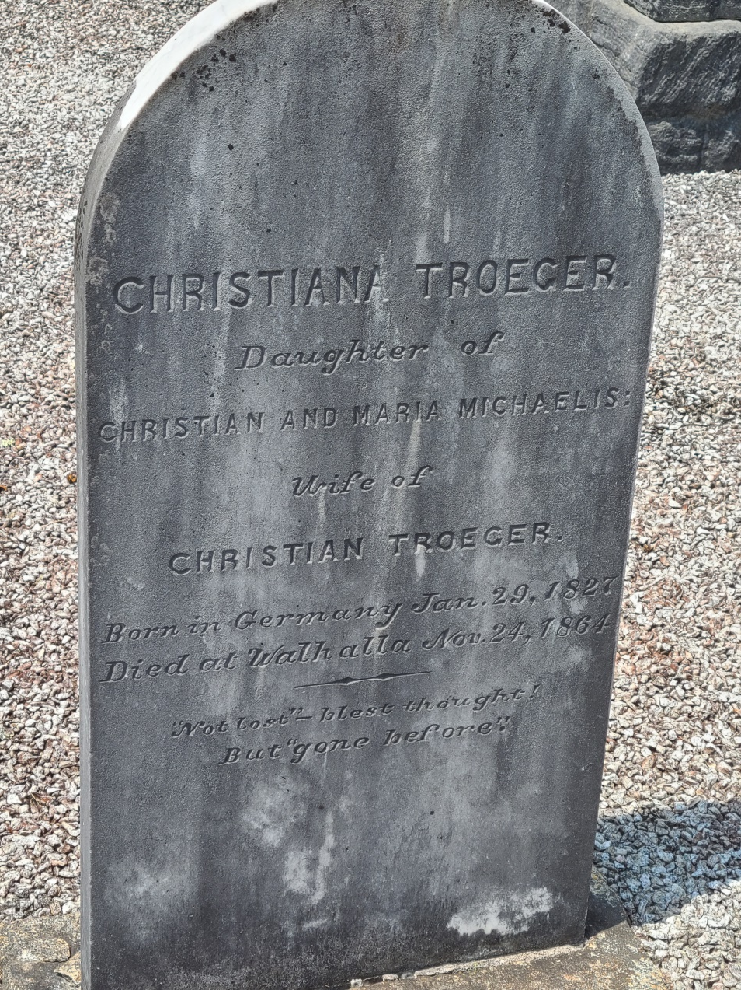
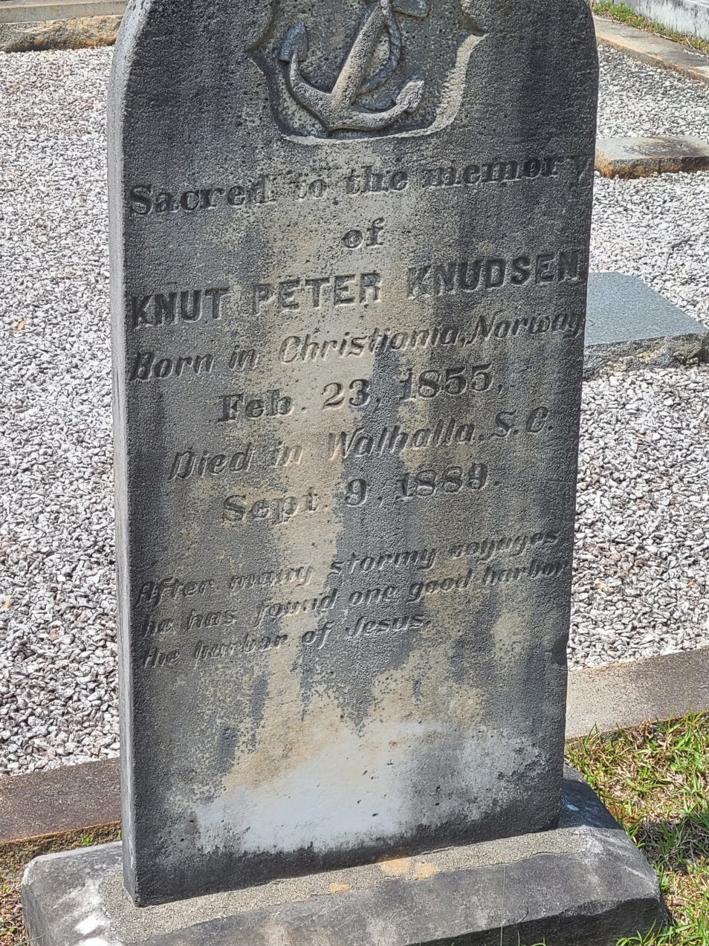

Slide 5
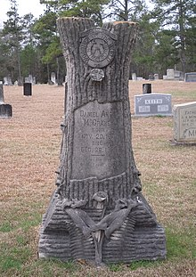
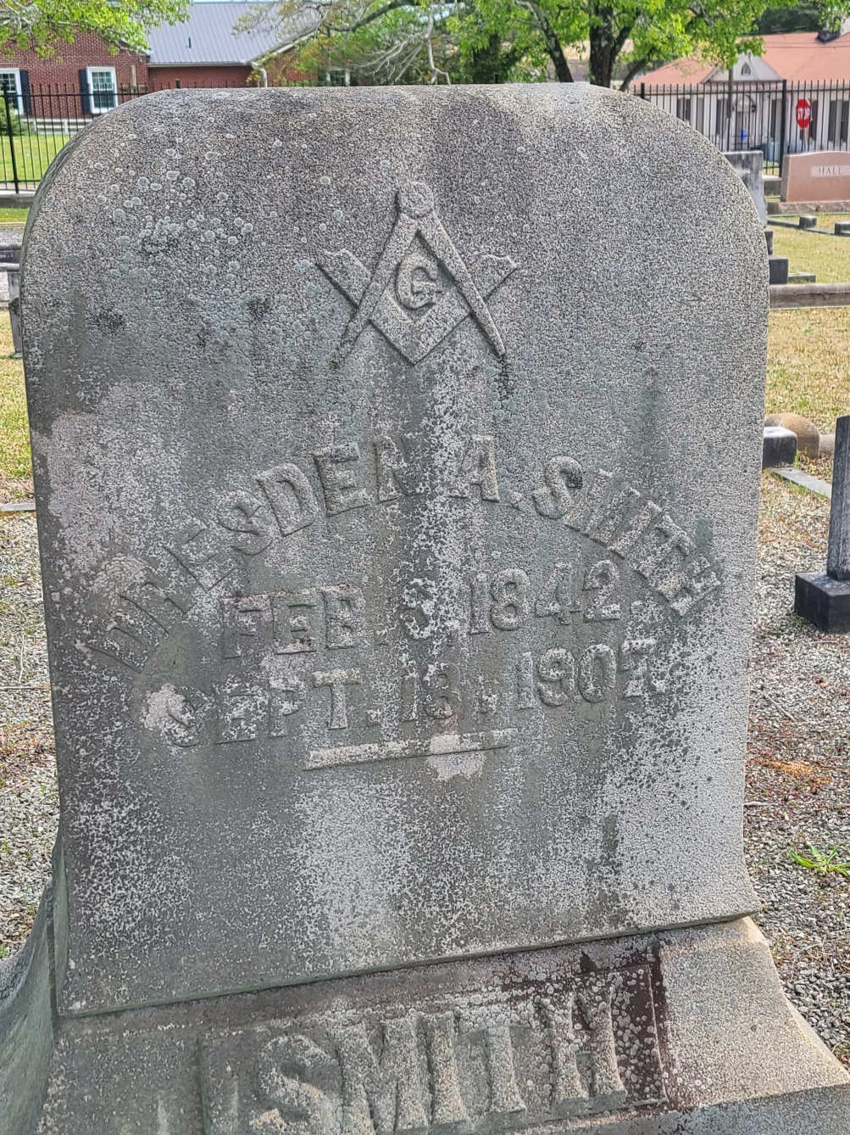

Slide 6
Threats to Cemeteries
Time
Weather
Vandalism
Construction/Inundation
Property transfers
Abandonment
How you can help:
Document, document, document!
Monitor & protect
Assist with preservation efforts
Advice about cleaning tombstones:
DO NO HARM
BE GENTLE & PATIENT
Soak stone with water before cleaning
Use a soft-bristle brush
Use only low-pressure water
Clean from bottom to top (avoids streaks)
Use a circular motion
Use LOTS of water
Don’t use chemical cleaners or herbicides if you don’t have to
NO bleach, acids, pressure washing, wire brushes, sandblasting, or power equipment (find a professional)

Slide 7
Identifying & Locating Historic Cemeteries
Where to obtain burial information:
Death Certificates
SC Death Index 1915-1967
Obituaries
Chronicling America
Newspapers.com
Ann Rogers Memorial South Carolina History Room at Oconee County Public Library
Church and/or funeral home records
Issues that may arise:
Incorrect information listed
Cemetery name has changed or misleading
Old and now incorrect location details (GPS coordinates, driving directions, etc…)
Church has closed or moved
Relocated cemeteries (inundation)
Abandoned/overgrown/vandalized cemeteries
Cemeteries on private property
Temporary grave markers used indefinitely
Unmarked graves (slaves, anyone too poor for a tombstone, etc…)

Slide 8
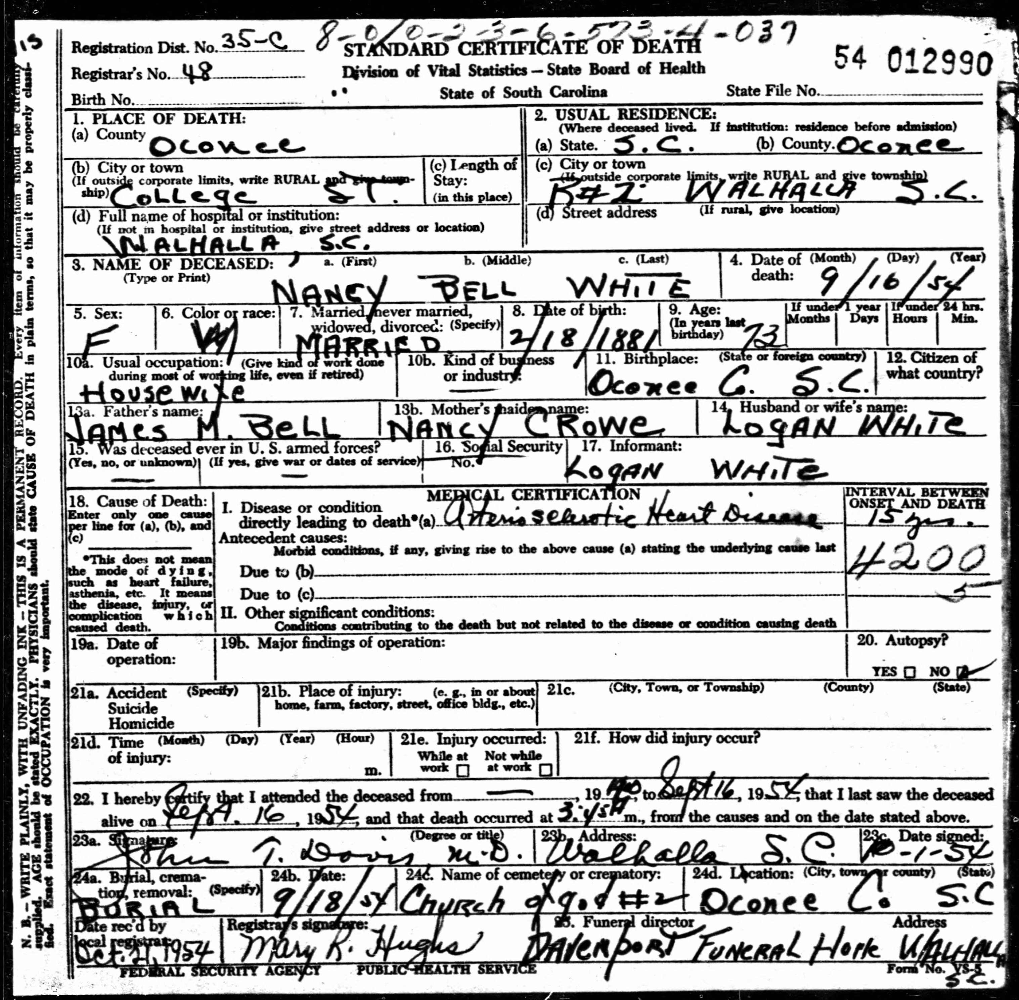

Slide 9
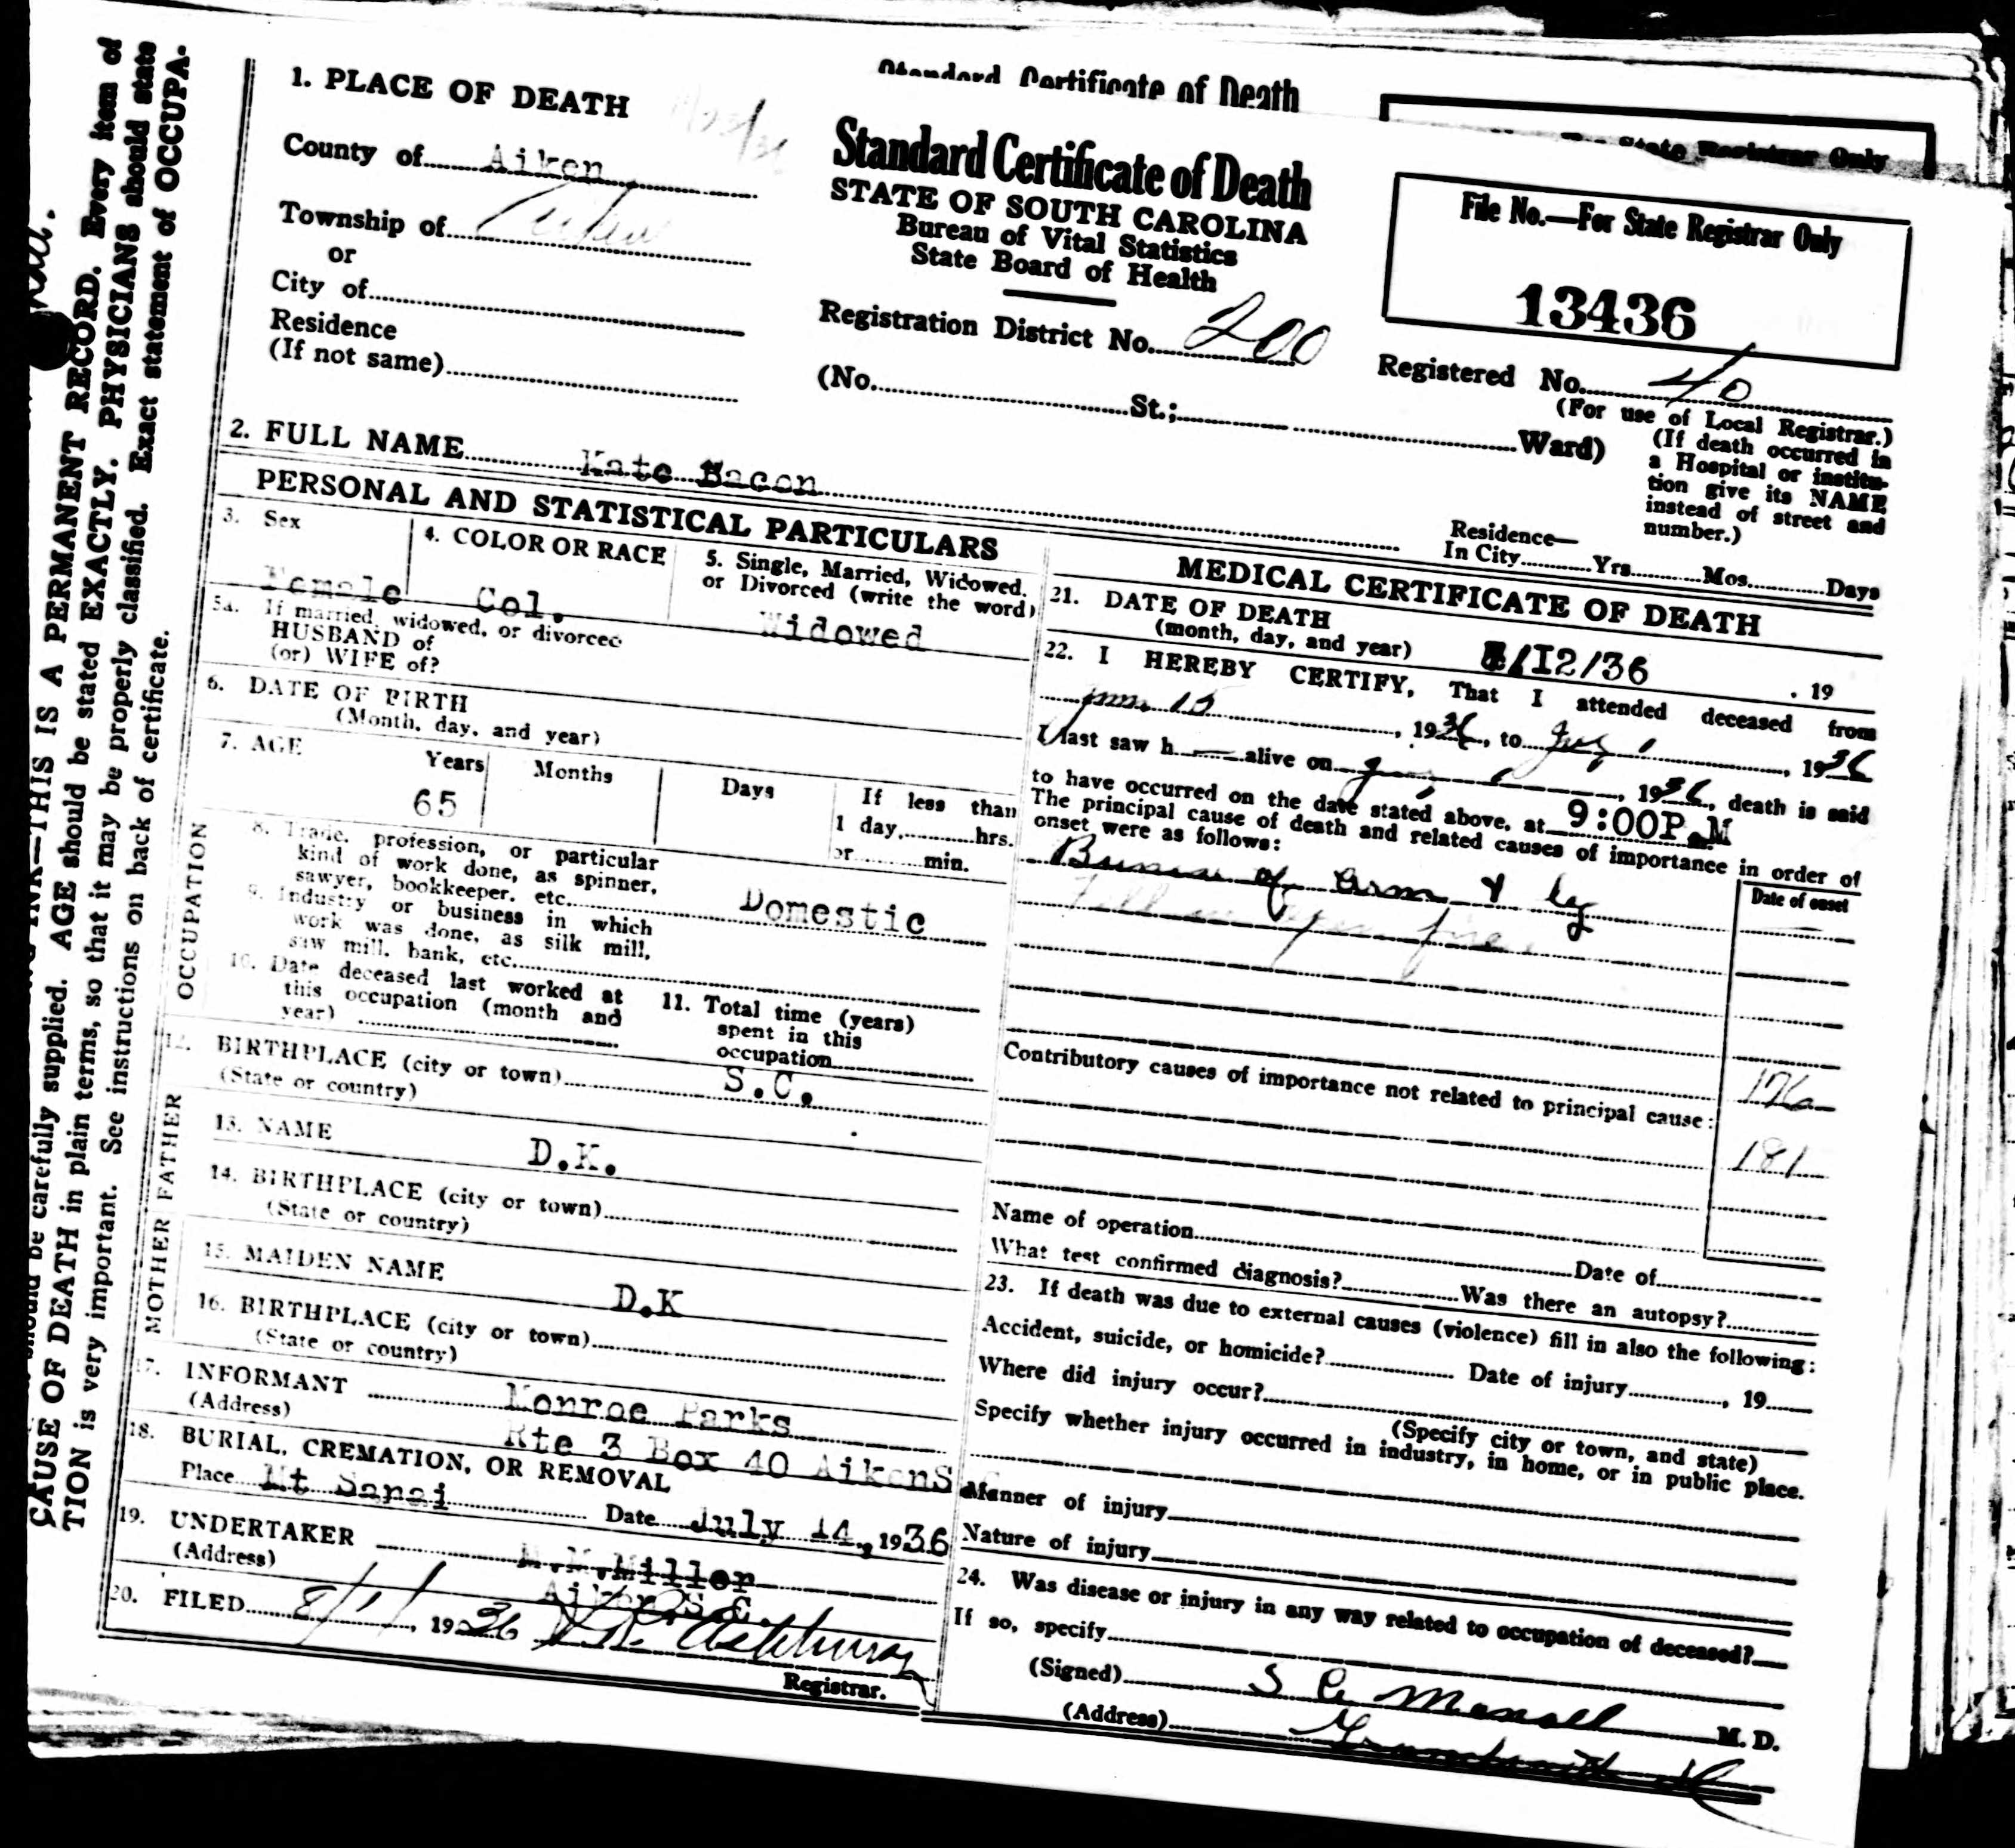

Slide 10
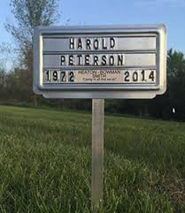
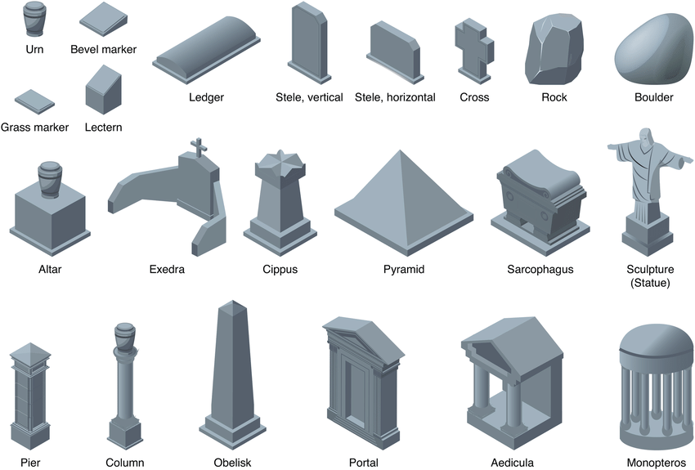
Example of common temporary grave marker (left)
Types of tombstones (below)

Slide 11
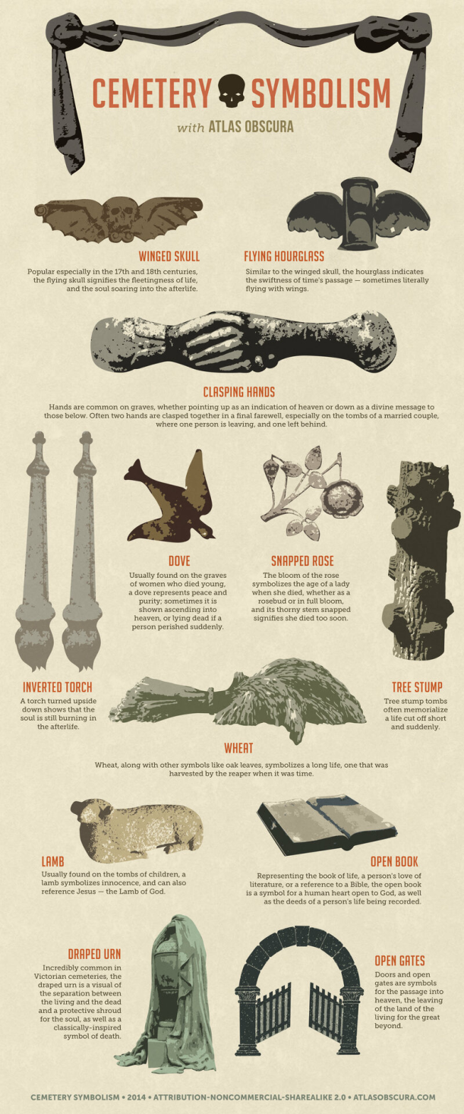
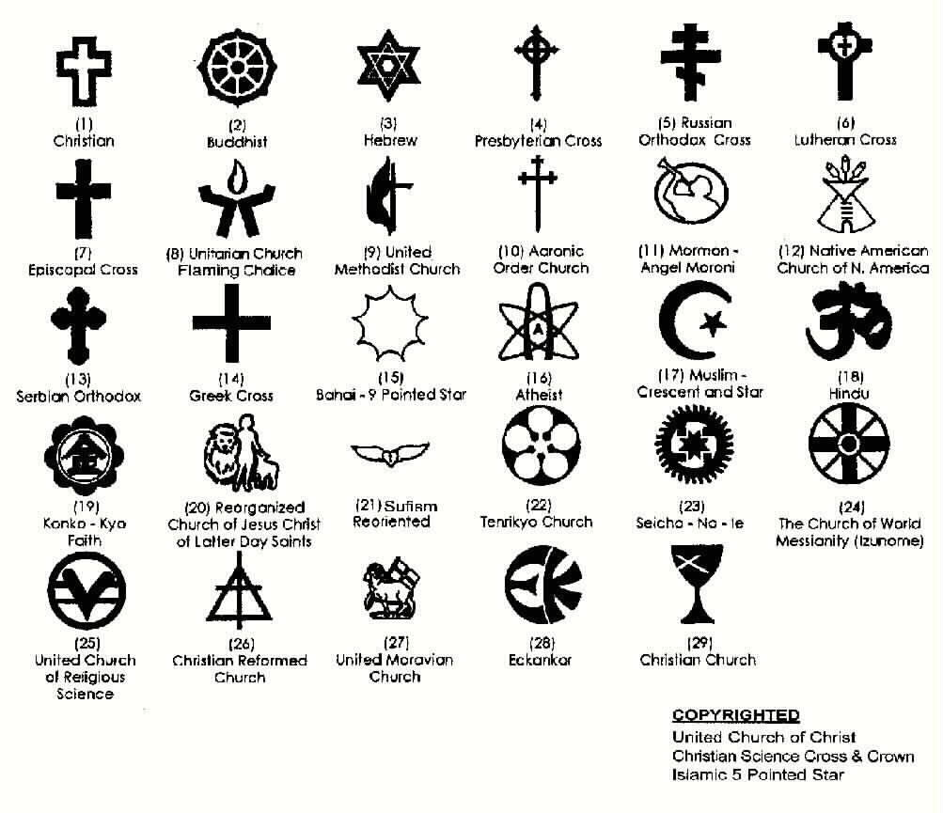
Tombstone Symbols

Slide 12
Cemetery Databases & Map Resources (FREE)
Crowdsourced Databases
Find-A-Grave.com
Billiongraves.com
Oconee County, SC, Cemetery Survey Projects
Ann Rogers Memorial South Carolina History Room at Oconee County Public Library
Historic maps featuring cemeteries
1953 Oconee County SC “Farm Plat Book & Business Guide”
Hartwell Project Maps (Oconee County GIS)
Map of Jocassee Valley pre-inundation
Can be found inside covers of Jocassee Valley by Claudia Whitmire Hembree
For veteran graves
US Veteran’s Affairs – Nationwide Gravesite Locator
American Battle Monuments Commission
United States Headstone Applications for U.S. Military Veterans, 1925-1949

Slide 13
Additional Resources
South Carolina Department of Archives and History
Cemeteries | SC Department of Archives and History
NPS Preservation Briefs
Preservation Brief 48: Preserving Grave Markers in Historic Cemeteries (nps.gov)
National Center for Preservation Technology and Training (NCPTT)
https://www.ncptt.nps.gov/blog/documentation/
Chicora Foundation
http://www.chicora.org/cemetery-forms.html

