Slide 1
How-To History:
Finding Deeds & Wills
Leslie Hagerty
Director/Curator
Oconee History Museum

Slide 2
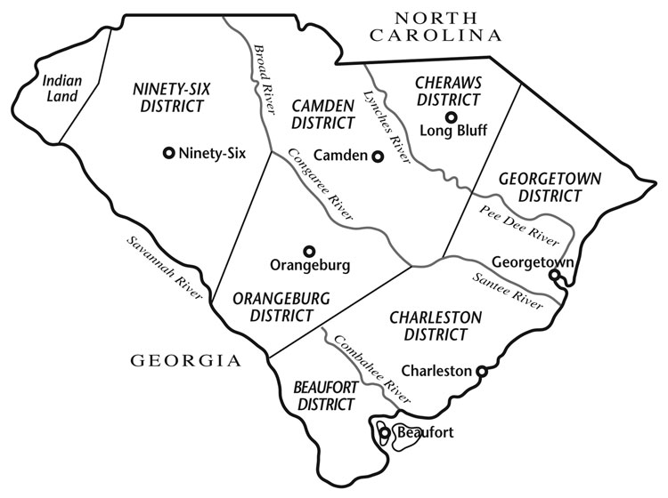
Establishing Boundaries
Understanding changes to South Carolina’s geo-political boundaries is essential to locating property, estate, and judicial documents.
Documents may remain in their County of origin, or they have have been relocated to the new seat of government in an area.
Oconee County’s modern boundaries are the result of South Carolina’s backcountry districts repeatedly dividing as populations grew.
Pre-history thru 1769 = “Indian Land”
1769 - 1799 = Ninety-Six District
Courthouse location: Ninety-Six

Slide 3
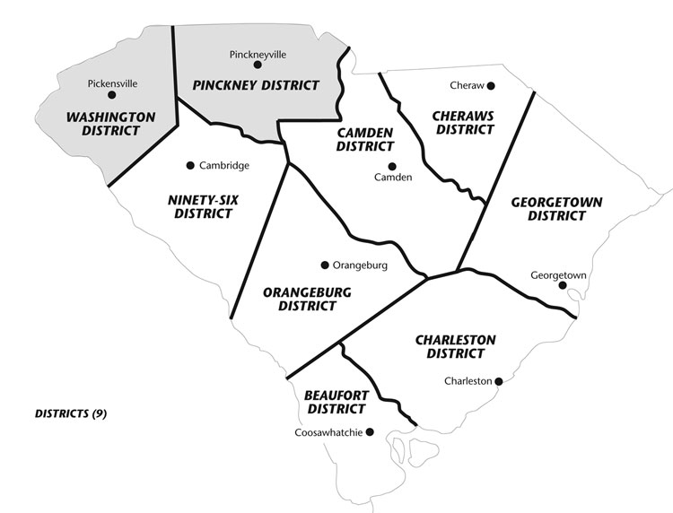
Establishing Boundaries
1791 - 1800 = Washington District
Washington District encompassed modern-day Oconee, Pickens, Anderson, and Greenville Counties.
Courthouse location: Pickensville (near present-day Easley)

Slide 4
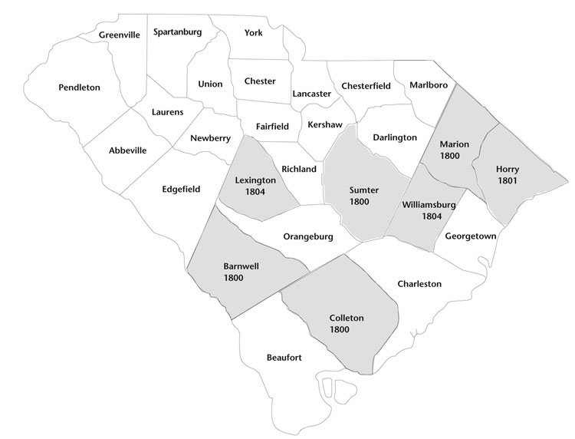
Establishing Boundaries
1789 - 1826 = Pendleton District
Pendleton District encompassed modern-day Oconee, Pickens, and Anderson Counties.
Courthouse location: Pendleton

Slide 5
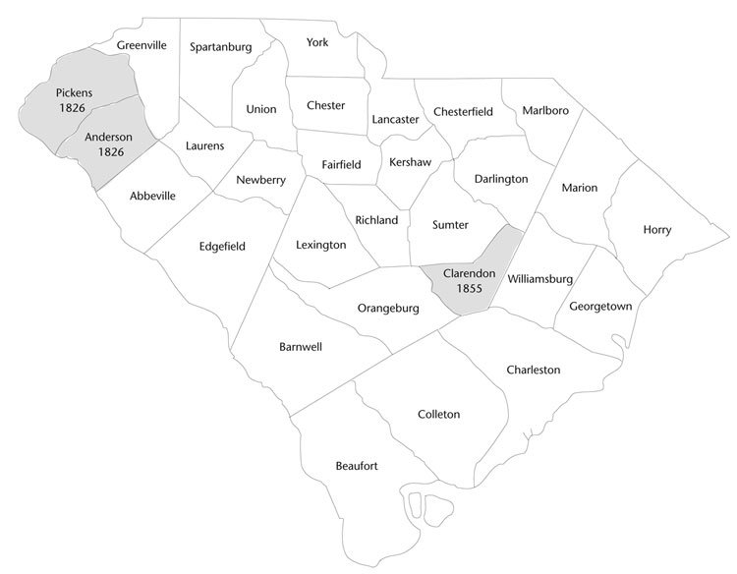
Establishing Boundaries
1826 - 1868 = Pickens District
Pickens District, sometimes Pickens Military District, encompassed modern-day Pickens and Oconee Counties.
Courthouse location: Pickens Courthouse (near present-day Duke Energy)

Slide 6
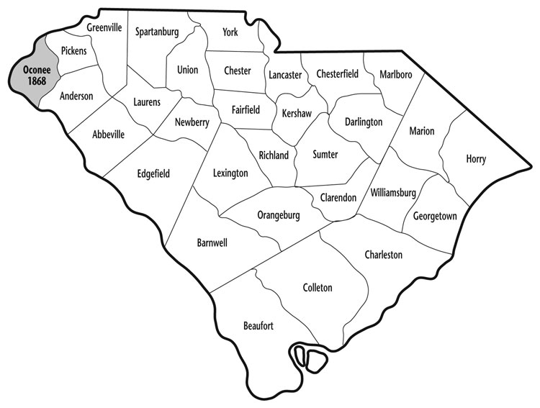
Establishing Boundaries
1868 - Present = Oconee County
The South Carolina Constitutional Convention of 1868 decided to divide the Pickens District into Pickens and Oconee Counties.
Courthouse locations: Walhalla, SC (Oconee) & Pickens, SC (Pickens)

Slide 7
Establishing Boundaries
Oconee County is a unique County in South Carolina because it borders:
2 states
North Carolina
Georgia
10 Counties:
South Carolina: Anderson & Pickens Counties
Georgia: Rabun, Habersham, Stephens, Franklin, & Hart Counties
North Carolina: Transylvania, Jackson, & Macon Counties
These borders have often been unclear and sometimes contested.
It is recommended that you also check with neighboring counties for historical records if the property in question is near a border.
Visit www.oconeesc.com for specific property information.

Slide 8
What We Can Learn From Deeds
Types of Deeds
What you can learn:
Ownership/residence & time period (important for Century Farms)
Description of land (usually does not include much information about houses/structures)
Family relationships (sale or bequest)
Neighbors
Be sure to check neighboring parcels as many family farms were carved up over time!

Slide 9
How To Read A Deed
http://landresearchnsw.info/deed_reading.html
https://www.familysearch.org/wiki/en/U.S._Land_Records_Class_Handout
Deed & Real Estate Terminology To Know:
http://www.bassriverhistory.org/uploads/6/8/7/1/6871754/old_deed_terms.pdf
https://www.atgf.com/tools-publications/glossary-real-estate-terms

Slide 10
Locating Deeds - Oconee County
Find the following records at the Oconee County Register of Deeds Office:
Deeds, Mortgages, & Plats ~ 1868 - present (view online 1965 to present)
State & Federal Tax Liens before November 2019
Mechanics & Assessment Liens
Housing Subdivisions
https://oconeesc.com/register-of-deeds-home
https://oconeesc.com/assessor-home/look-up-property-info

Slide 11
Locating Deeds - Pickens County
Find the following records at the Pickens County Register of Deeds Office:
Deeds & plats back to 1868 (some pre-1868)
Mortgages since late 1800s
https://www.co.pickens.sc.us/departments/register_of_deeds/index.php

Slide 12
Locating Deeds - Anderson County
Find the following records at the Anderson County Register of Deeds Office:
Deeds back to 1869
Mortgages & Plats
https://www.andersoncountysc.org/departments-a-z/register-of-deeds/

Slide 13
Understanding Wills & Probate Court
Probate courts in South Carolina validate wills, handle the administration of estates, appoint guardians for minors, approve involuntary mental health commitments, and issue marriage licenses.
The purpose of wills include:
Specifying the distribution of owned property
Providing for the support of widows/dependents
Applying conditions and contingencies
Wills were not necessarily executed in a prompt manner.
Glossary of probate terms

Slide 14
What We Can Learn From Wills & Probate Documents
Full name and place of death
Marital status
Name of spouse
Names of children (and possibly birth order)
Names of children's spouses of married daughters
Names of grandchildren
Relationships between family members
Clues to the trade or occupation of your ancestor
Citizenship
Residences of your ancestor and living descendants
Locations (and descriptions) where your ancestor owned property
Feelings of your ancestor toward family members
Clues to the deaths of other family members
Clues to adoptions or guardianships
Inventory of items owned by the deceased
Clues to your ancestor's economic standing (e.g. debts, property)
Your ancestor's signature

Slide 15
Locating Wills & Estate Documents - Oconee County
Find the following records at the Oconee County Probate Court:
Estate files dating from the mid-1850s
Marriage licenses (1911 - present)
Guardianship & conservatorship (1983 - present)
Mental health (not public record)
Most online records only go back to 1988
https://oconeesc.com/probate-home

Slide 16
Locating Wills & Estate Documents - Pickens County
Find the following records at the Pickens County Probate Court:
Estate files dating back to 1828
Marriage licenses (1911 - present)
https://www.co.pickens.sc.us/departments/probate_court/index.php

Slide 17
Locating Wills & Estate Documents - Anderson County
Find the following records at the Anderson County Probate Court:
Estate files back to 1876
Marriage licenses (1911 - present)
https://www.andersoncountysc.org/departments-a-z/probate-court/

Slide 18
Compilation Books & Resources
Pendleton District, SC, Deeds 1790 - 1806
Pendleton District, SC, Deeds 1807 - 1810
Abstracts of Pickens District, South Carolina, Deed Books
Pickens District, SC 1866 Tax List (available at Oconee History Museum)
Ann Rogers Memorial South Carolina History Room at Oconee County Public Library
FamilySearch.org
Pendleton District and Anderson County, S.C. Wills, Estates, Inventories, Tax Returns and Census Record
Abstracts of the Wills of the State of South Carolina 1760 - 1784
A genealogical collection of South Carolina wills and records
Faith Clayton Room at Southern Wesleyan University
South Carolina State Archives

